Slide 1
Neural Architectures with Memory
Nitish Gupta, Shreya Rajpal
25th April, 2017

Slide 2
Story Comprehension
Joe went to the kitchen. Fred went to the kitchen. Joe picked up the milk. Joe travelled to his office. Joe left the milk. Joe went to the bathroom.
Questions from Joe’s angry mother:
Q1 : Where is Joe?
Q2 : Where is the milk now?
Q3 : Where was Joe before the office?

Slide 3
Dialogue System
Hello! What can I do for you today?
I’d like to reserve a table for 6.
Sure! When would you like that reservation?
At 7 PM, please.
Okay. What cuisine would you like?
Actually make that 7:30 PM
Updated! What cuisine?
Is there anything better than a medium rare steak?
Nothing at all! Blackdog has a 4.7 on Yelp.
Sounds perfect! Also, add one more person.
Reservation done for 7, 7:30pm at Blackdog. Enjoy!
Machine
Human

Slide 4
ML models need memory!
Deeper AI tasks require explicit memory and
multi-hop reasoning over it
RNNs have short memory
Cannot increase memory without increasing number of parameters
Need for compartmentalized memory
Read/Write should be asynchronous

Slide 5
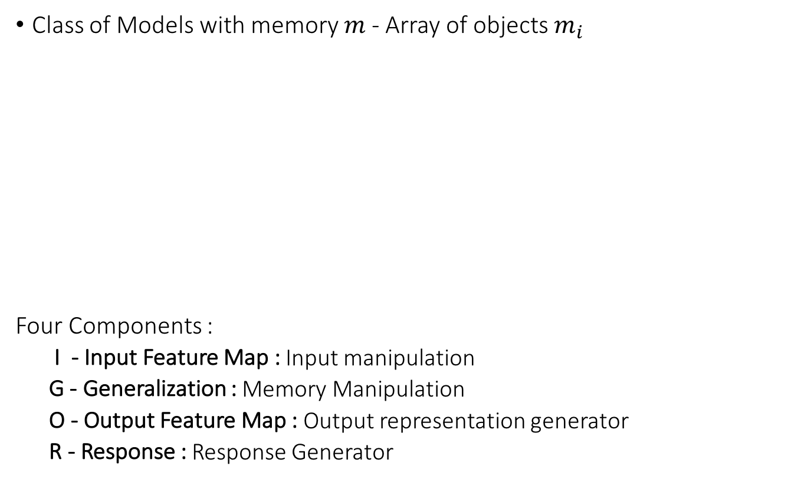
Memory Networks (MemNN)
Class of Models with memory $m$ - Array of objects $m_{i}$
Four Components :
I - Input Feature Map : Input manipulation
G - Generalization : Memory Manipulation
O - Output Feature Map : Output representation generator
R - Response : Response Generator
Each memory here is a dense vector
Memory Networks, Weston et. al., ICLR 2015

Slide 6
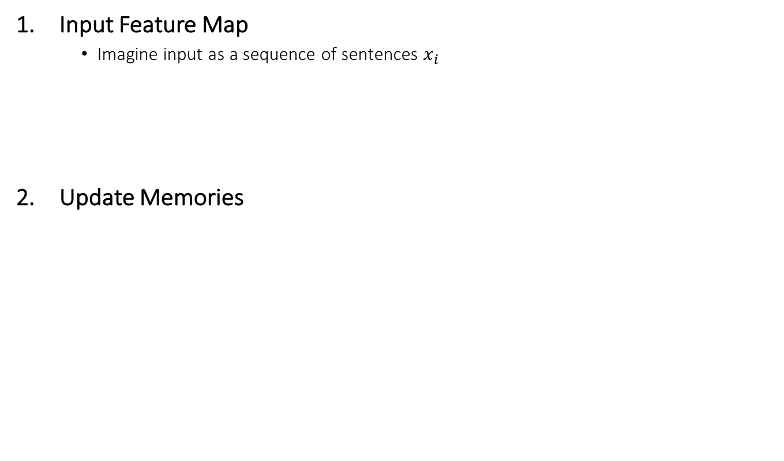
MemNN
Input Feature Map
Imagine input as a sequence of sentences $x_{i}$
Update Memories
Memory Networks, Weston et. al., ICLR 2015

Slide 7
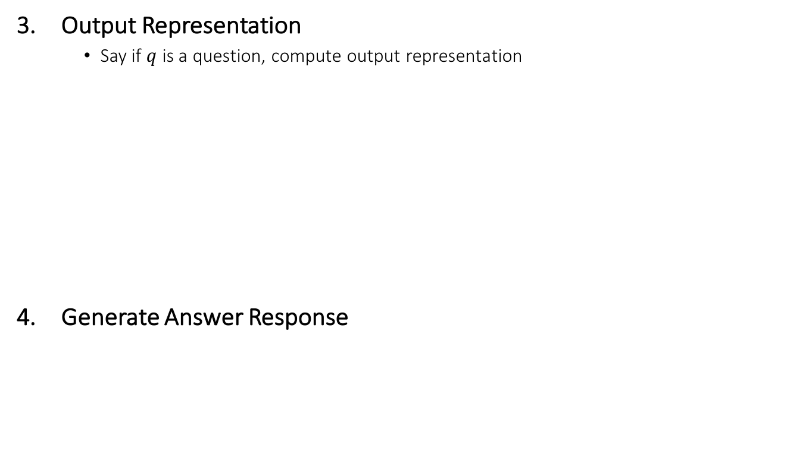
MemNN
Output Representation
Say if $q$ is a question, compute output representation
Generate Answer Response
Memory Networks, Weston et. al., ICLR 2015

Slide 8
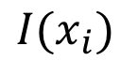
Simple MemNN for Text
Input Feature Map - Bag-of-Words representation
$$I(x_{i})$$
Sentence
Bag-of-Words
Memory Networks, Weston et. al., ICLR 2015

Slide 9
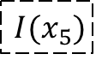
Simple MemNN for Text
Generalization : Store input in new memory
Memories till now (i=4)
Memories after 5 inputs
$${I(x}_{5})$$
Memory Networks, Weston et. al., ICLR 2015

Slide 10
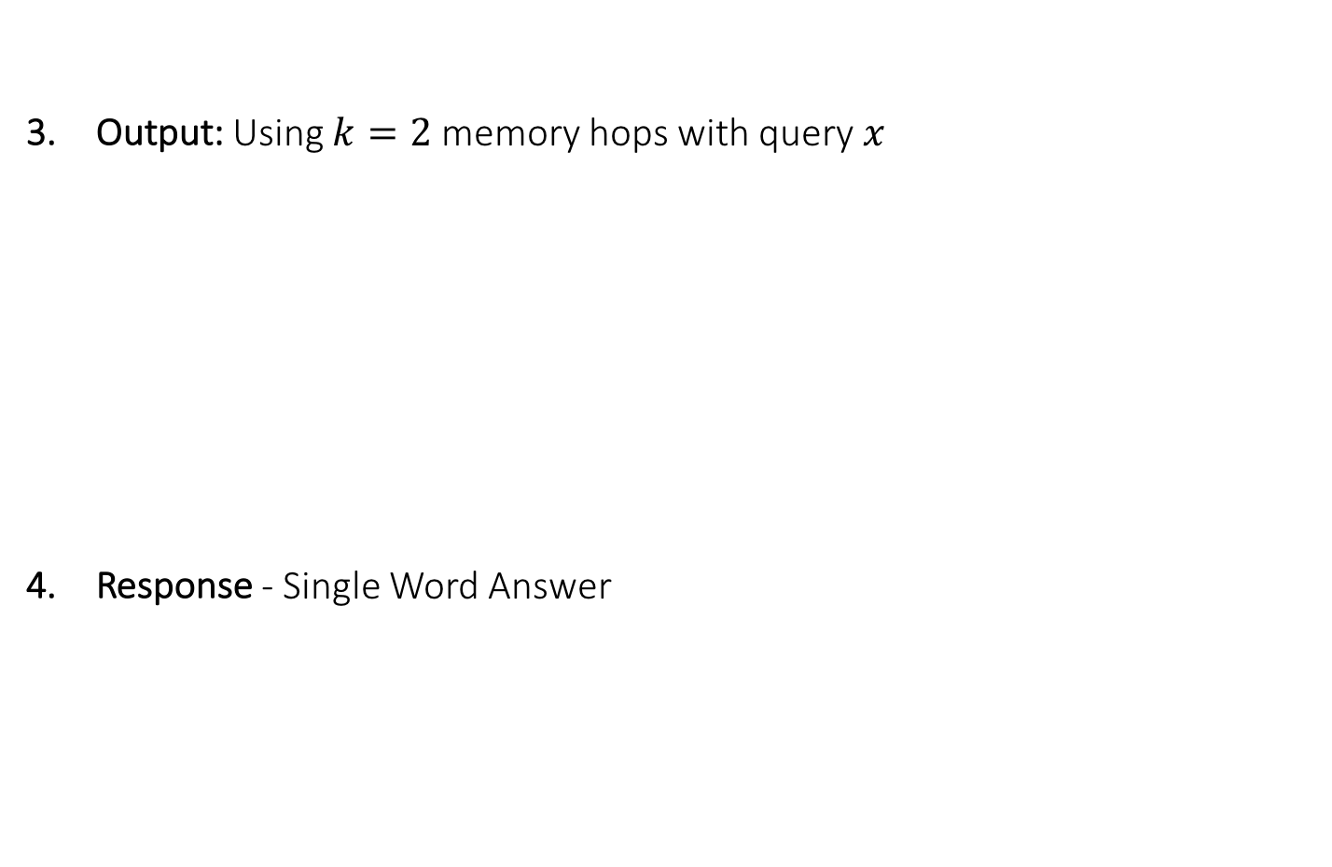
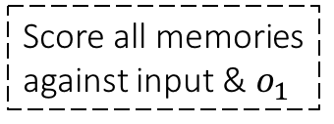
Simple MemNN for Text
Output: Using $k=2$ memory hops with query $x$
Response - Single Word Answer
Score all memories against input
1st Max scoring memory index
2nd Max scoring memory index
Score all memories against input & $o_{1}$
Score all words against query and 2 supporting memories
Max scoring word
Memory Networks, Weston et. al., ICLR 2015

Slide 11
Scoring Function
Scoring Function is an embedding model
What is $Uy$ ?
Scoring Function is just dot-product between sum of word embeddings!!!
Memory Networks, Weston et. al., ICLR 2015

Slide 12
Joe went to the kitchen.
Fred went to the kitchen.
Joe picked up the milk.
Joe travelled to his office.
Joe left the milk. Joe went to the bathroom.
Input Sentences
Memories
Where is the milk now?
Question
1st supporting memory
Where is the milk now?
Question
2nd supporting memory
Where is the milk now?
Office
Question
Response
Memory Networks, Weston et. al., ICLR 2015

Slide 13
Training Objective
Score for true 1st memory
Score for a negative memory
Memory Networks, Weston et. al., ICLR 2015

Slide 14
Training Objective
Score for true 2nd memory
Score for a negative memory
Memory Networks, Weston et. al., ICLR 2015

Slide 15
Training Objective
Score for true response
Score for a negative response
Memory Networks, Weston et. al., ICLR 2015

Slide 16
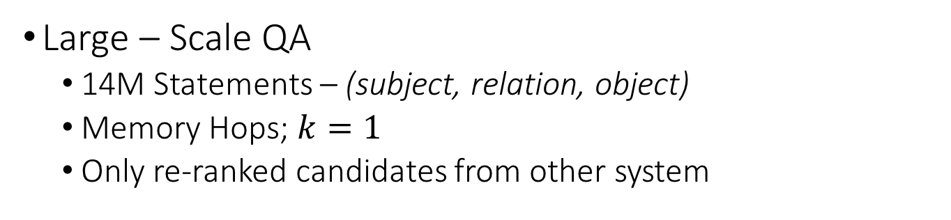
Experiment
Stored as memories
Large – Scale QA
14M Statements – (subject, relation, object)
Memory Hops; $k=1$
Only re-ranked candidates from other system
Output is highest scoring memory
Method | F1
Fader et. al. 2013 | 0.54
Bordes et. al. 2014b | 0.73
Memory Networks (This work) | 0.72
Why does Memory Network perform exactly as previous model?
Memory Networks, Weston et. al., ICLR 2015

Slide 17
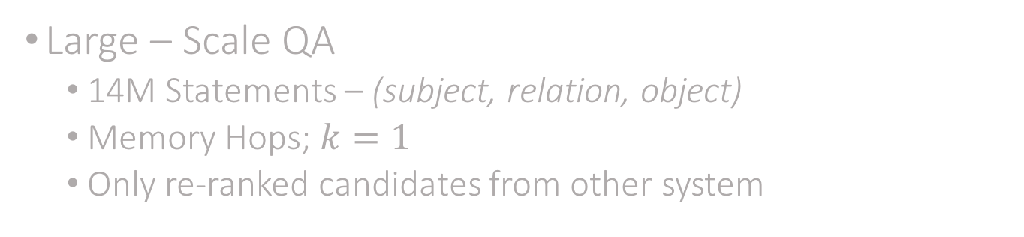
Experiment
Large – Scale QA
14M Statements – (subject, relation, object)
Memory Hops; $k=1$
Only re-ranked candidates from other system
USELESS EXPERIMENT
Method | F1
Fader et. al. 2013 | 0.54
Bordes et. al. 2014b | 0.73
Memory Networks (This work) | 0.72
Why does Memory Networks not perform as well?

Slide 18
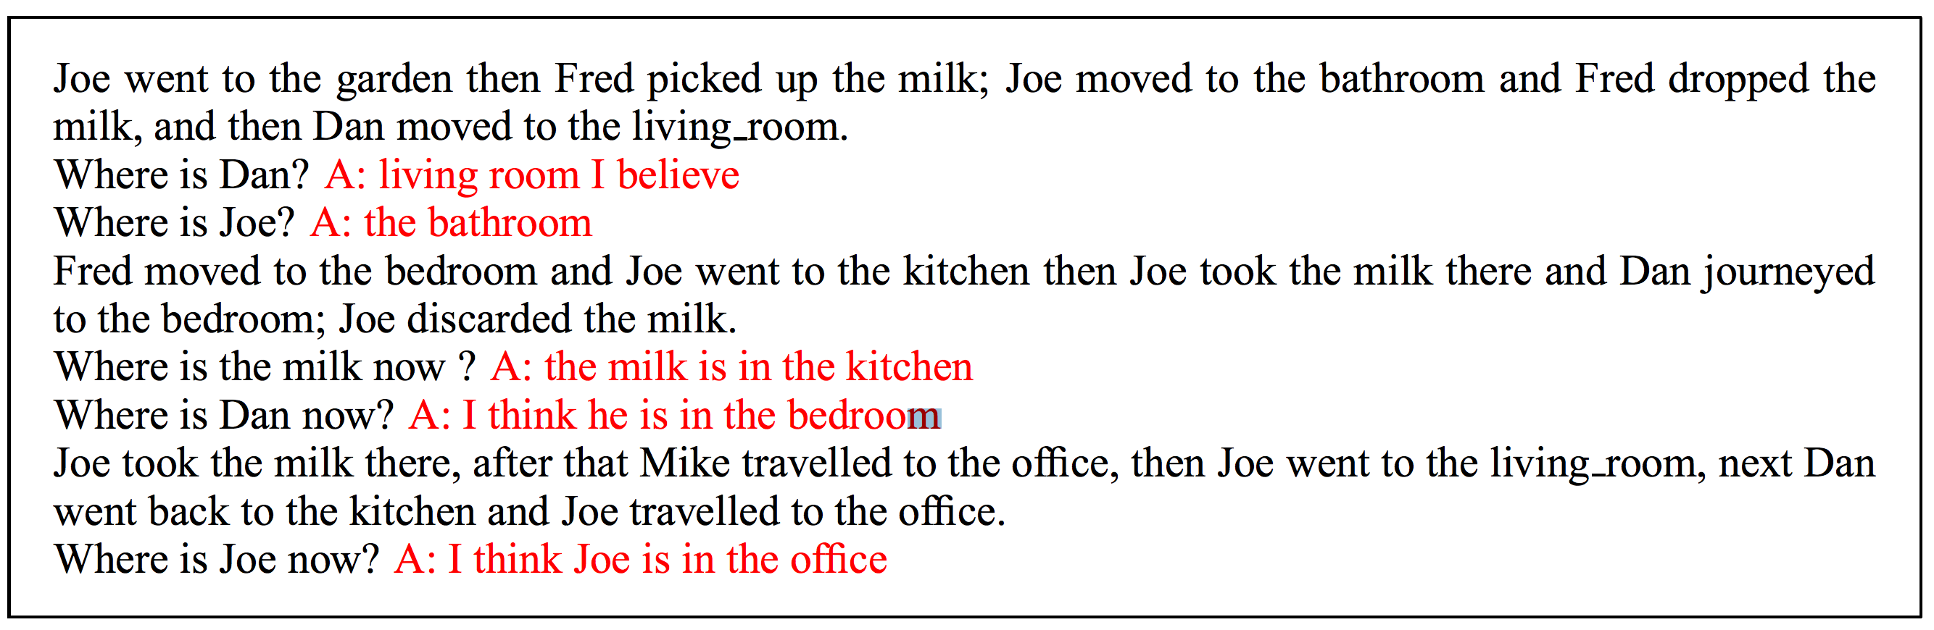
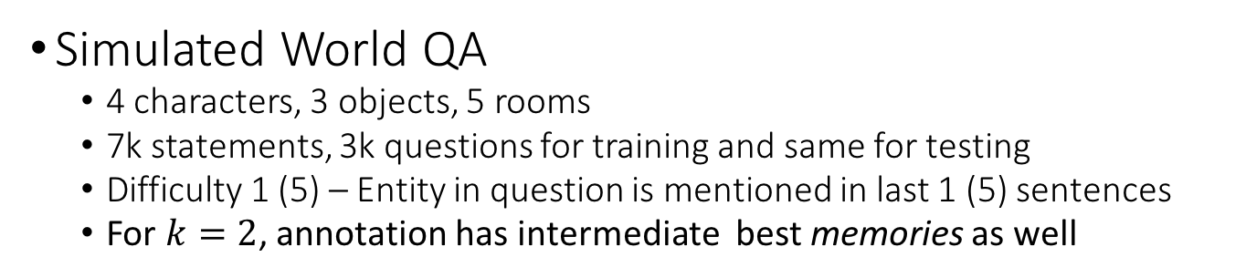
Useful Experiment
Simulated World QA
4 characters, 3 objects, 5 rooms
7k statements, 3k questions for training and same for testing
Difficulty 1 (5) – Entity in question is mentioned in last 1 (5) sentences
For $k=2$, annotation has intermediate best memories as well
Memory Networks, Weston et. al., ICLR 2015

Slide 19
Limitations
Simple BOW representation
Simulated Question Answering dataset is too trivial
Strong supervision i.e. for intermediate memories is needed
Memory Networks, Weston et. al., ICLR 2015

Slide 20
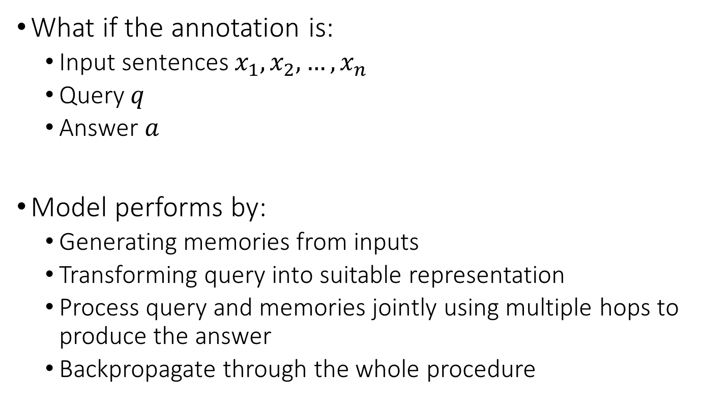
End-to-End Memory Networks (MemN2N)
What if the annotation is:
Input sentences $x_{1}, x_{2}, …, x_{n}$
Query $q$
Answer $a$
Model performs by:
Generating memories from inputs
Transforming query into suitable representation
Process query and memories jointly using multiple hops to produce the answer
Backpropagate through the whole procedure
Joe went to the kitchen. Fred went to the kitchen. Joe picked up the milk. Joe travelled to his office. Joe left the milk. Joe went to the bathroom.
Where is the milk now?
Office
End-To-End Memory Networks, Sukhbaatar et. al., NIPS 2015

Slide 21
MemN2N
Convert input to memories $x_{i}→m_{i}$
BOW input
Sum of word-embeddings
Word-Embedding Matrix
Transform query $q$ into same representation space
Output Vectors $x_{i}→c_{i}$
End-To-End Memory Networks, Sukhbaatar et. al., NIPS 2015

Slide 22
MemN2N
Scoring memories against query
Memories
Score for
input/memory
Query (transformed)
Generate output
Weighted average of all inputs (transformed)
End-To-End Memory Networks, Sukhbaatar et. al., NIPS 2015

Slide 23
MemN2N
Generating Response
Distribution over response words
Query
Averaged-output
Training Objective – Maximum Likelihood / Cross Entropy
End-To-End Memory Networks, Sukhbaatar et. al., NIPS 2015

Slide 24
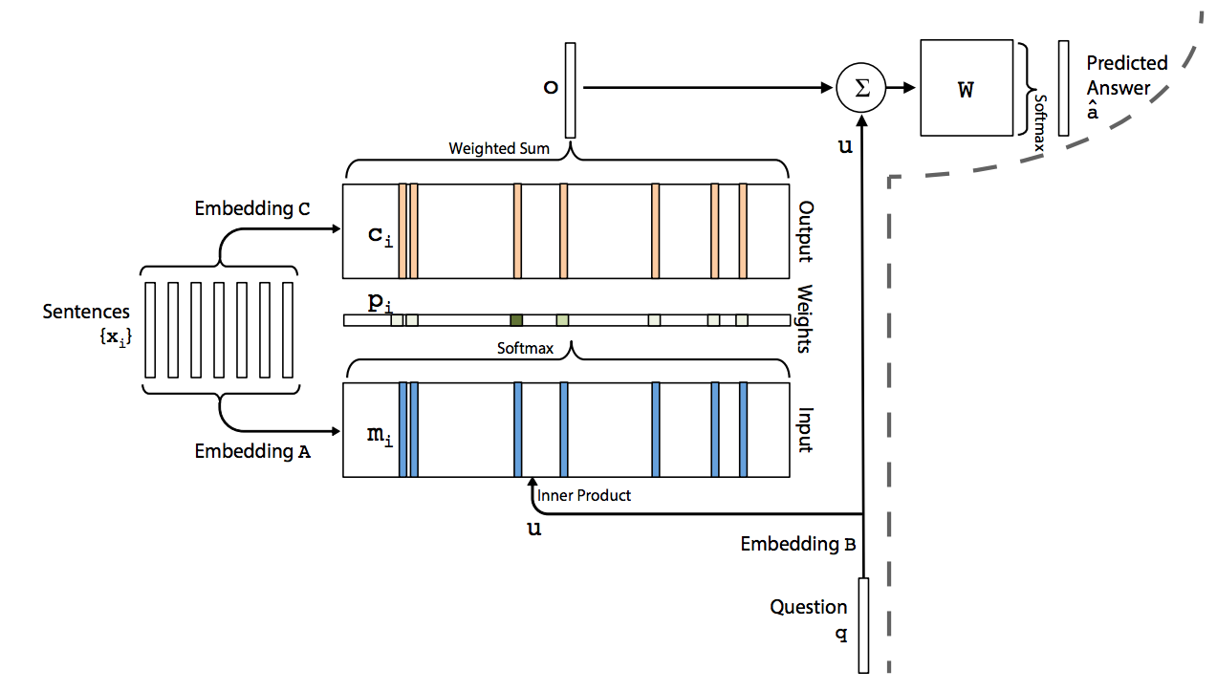
Make averaged output
Response
Score memories
Generate outputs
Generate memories
TransformQuery
End-To-End Memory Networks, Sukhbaatar et. al., NIPS 2015

Slide 25
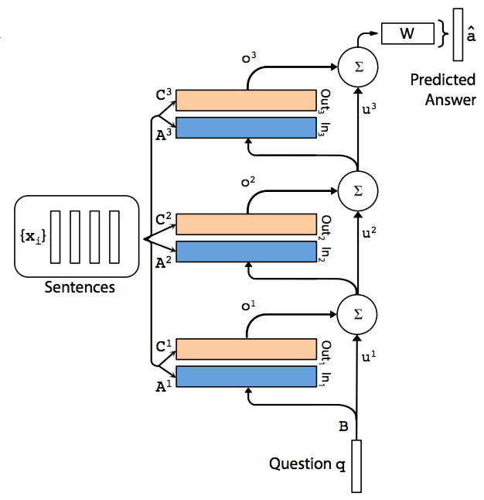
Multi-hop MemN2N
Hop 3
Hop 2
Different Memories and Outputs for each Hop
Hop 1
End-To-End Memory Networks, Sukhbaatar et. al., NIPS 2015

Slide 26
Experiments
Simulated World QA
20 Tasks from bAbI dataset - 1K and 10K instances per task
Vocabulary = 177 words only!!!!!
60 epochs
Learning Rate annealing
Linear Start with different learning rate
“Model diverged very often, hence trained multiple models”
End-To-End Memory Networks, Sukhbaatar et. al., NIPS 2015

Slide 27
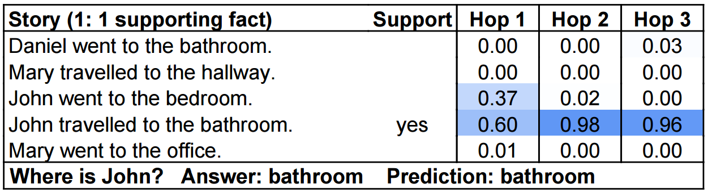
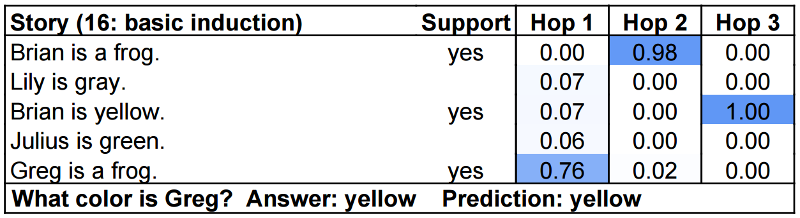
 | MemNN | MemN2N
Error % (1k) | 6.7 | 12.4
Error % (10k) | 3.2 | 7.5
End-To-End Memory Networks, Sukhbaatar et. al., NIPS 2015

Slide 28
Movie Trivia Time!
Subject
Relation
Object
Which was Stanley Kubricks’s first movie?
(2001:a_space_odyssey, directed_by, stanley_kubrick)
(fear_and_dark, directed_by, stanley_kubrick)
…
(fear_and_dark, released_in, 1953)
(full_metal_jacket, released_in, 1987)
…
(2001:a_space_odyssey, released_in, 1968)
…
(the_shining, directed_by, stanley_kubrick)
…
(AI:artificial_intelligence, written_by, stanley_kubrick)
Fear and Desire
When did 2001:A Space Odyssey release?
1968
After The Shining, which movie did its director direct?
Full Metal Jacket
Knowledge Base

Slide 29


Knowledge Base?
Textual Knowledge?
(2001:a_space_odyssey, directed_by, stanley_kubrick)
(fear_and_dark, directed_by, stanley_kubrick)
…
(fear_and_dark, released_in, 1953)
(full_metal_jacket, released_in, 1987)
…
(2001:a_space_odyssey, released_in, 1968)
…
(the_shining, directed_by, stanley_kubrick)
…
(AI:artificial_intelligence, written_by, stanley_kubrick)
Incomplete!
Too Challenging!
Combine using Memory Networks?

Slide 30
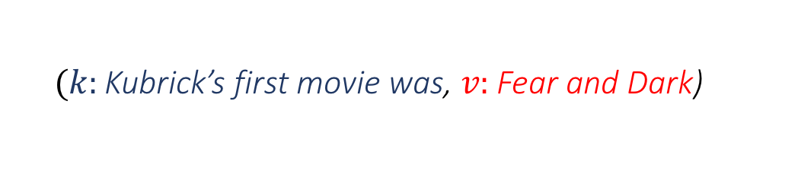
Key-Value MemNNs for Reading Documents
Structured Memories as Key-Value Pairs
Regular MemNNs have single vector for each memory
Key more related to question and values to answer
$(k:$Kubrick’s first movie was, $v:$ Fear and Dark)
Keys and Values can be Words, Sentences, Vectors etc.
Key-Value Memory Networks for Directly Reading Documents, Miller et. al., EMNLP 2016

Slide 31
KV-MemNN
Retrieve relevant memories using Hashing Techniques
Retrieved Relevant Memories
All Memories
Use inverted index, locality sensitive hashing, something sensible
Key-Value Memory Networks for Directly Reading Documents, Miller et. al., EMNLP 2016

Slide 32
KV-MemNN
Score Memory-Keys
Distribution over Memory-Keys
Key
Dot-Prod
Sum of Embeddings
BOW
Generate Output
Weighted average of Memory-values
Key-Value Memory Networks for Directly Reading Documents, Miller et. al., EMNLP 2016

Slide 33
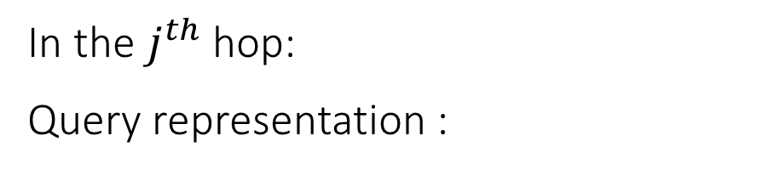
KV-MemNN - Multiple Hops
In the $j^{th}$ hop:
Query representation :
Key Addressing
Generate Response
Final Hop
Key-Value Memory Networks for Directly Reading Documents, Miller et. al., EMNLP 2016

Slide 34
KV-MemNN – What to store in memories?
KB Based :
Key: (subject, relation); Value: Object
K: (2001:a_space_odyssey, directed_by); V: stanley_kubrick
Document Based
For each entity in document, extract 5-word window around it
Key: window; Value: Entity
K: screenplay written by and; V: Hampton
Key-Value Memory Networks for Directly Reading Documents, Miller et. al., EMNLP 2016

Slide 35
KV-MemNN – Experiments
WikiMovies Benchmark
Total 100K QA-pairs
10% for testing
Method | KB | Doc
E2E Memory Network | 78.5 | 69.9
Key-Value Memory Network | 93.9 | 76.2
Key-Value Memory Networks for Directly Reading Documents, Miller et. al., EMNLP 2016

Slide 36
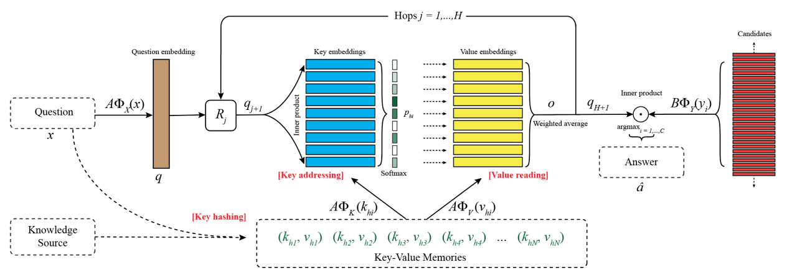
KV-MemNN
Generate Output using Averaged Memory-Values
Score relevant Memory-Keys
Retrieve relevant Memories
Generate Response
Key-Value Memory Networks for Directly Reading Documents, Miller et. al., EMNLP 2016

Slide 37
KV-MemNN
Key-Value Memory Networks for Directly Reading Documents, Miller et. al., EMNLP 2016

Slide 38
CNN : Computer Vision :: ________ : NLP
RNN
Key-Value Memory Networks for Directly Reading Documents, Miller et. al., EMNLP 2016

Slide 39
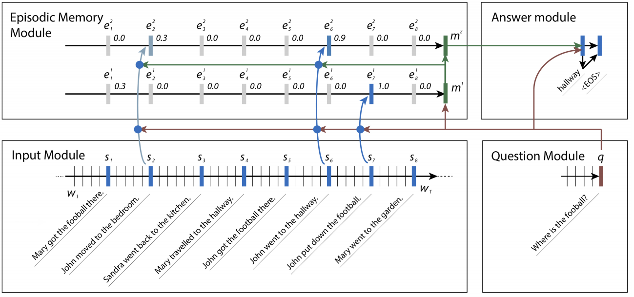
Dynamic Memory Networks – The Beast
Use RNNs, specifically GRUs for every module
Ask Me Anything: Dynamic Memory Networks for Natural Language Processing, Kumar et. al. ICML 2016

Slide 40
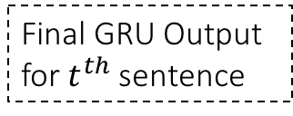
DMN
Final GRU Output for $t^{th}$ sentence
Ask Me Anything: Dynamic Memory Networks for Natural Language Processing, Kumar et. al. ICML 2016

Slide 41
DMN
Ask Me Anything: Dynamic Memory Networks for Natural Language Processing, Kumar et. al. ICML 2016

Slide 42
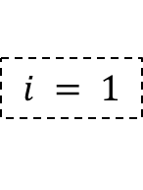
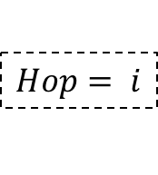
DMN
$$Hop= i$$
$$i = 1$$
Ask Me Anything: Dynamic Memory Networks for Natural Language Processing, Kumar et. al. ICML 2016

Slide 43
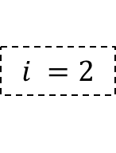
DMN
$$Hop= i$$
$$i =2$$
Ask Me Anything: Dynamic Memory Networks for Natural Language Processing, Kumar et. al. ICML 2016

Slide 44
DMN
Ask Me Anything: Dynamic Memory Networks for Natural Language Processing, Kumar et. al. ICML 2016

Slide 45
DMN
Ask Me Anything: Dynamic Memory Networks for Natural Language Processing, Kumar et. al. ICML 2016

Slide 46
DMN
How many GRUs were used with 2 hops?
Ask Me Anything: Dynamic Memory Networks for Natural Language Processing, Kumar et. al. ICML 2016

Slide 47
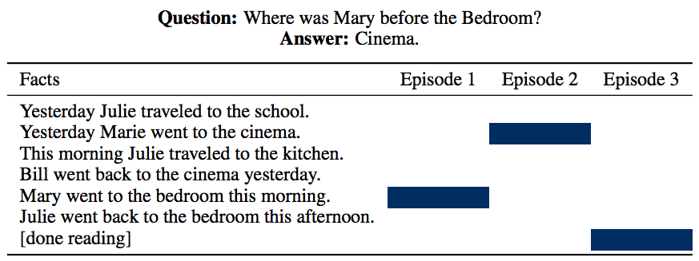
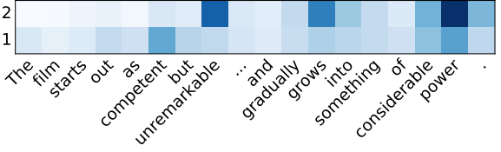
DMN – Qualitative Results
Ask Me Anything: Dynamic Memory Networks for Natural Language Processing, Kumar et. al. ICML 2016

Slide 48
Algorithm Learning

Slide 49
Neural Turing Machine
Copy Task: Implement the Algorithm
Given a list of numbers at input, reproduce the list at output
Neural Turing Machine Learns:
What to write to memory
When to write to memory
When to stop writing
Which memory cell to read from
How to convert result of read into final output

Slide 50
Neural Turing Machines
External Input
External Output
Controller
‘Blurry’
Write Heads
Read Heads
Memory
Neural Turing Machines, Graves et. al., arXiv:1410.5401
Notes:
Input/ Output like regular neural network
Controller – Feedforward/LSTM network
Operators (called ‘heads’) to interact with memory matrix
‘Blurry’ read and write to make network differentiable

Slide 51
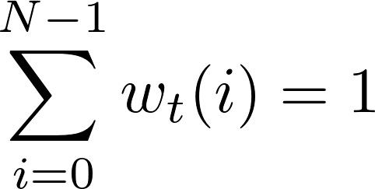
Neural Turing Machines
‘Blurry’ Memory Addressing
(at time instant ‘t’)
M_{t}
w_{t}
Soft Attention (Lectures 2, 3, 20, 24)
N
w_{t}(0) = 0.1 | w_{t}(1) = 0.2 | w_{t}(2) = 0.5 | w_{t}(3) = 0.1 | w_{t}(4) = 0.1
M
Neural Turing Machines, Graves et. al., arXiv:1410.5401

Slide 52
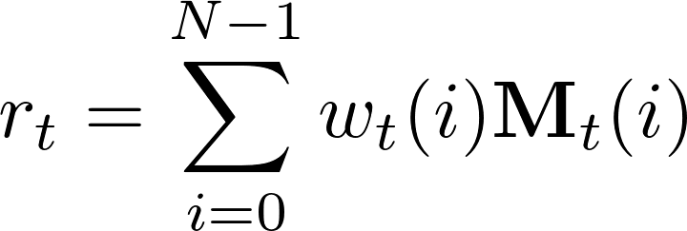
Neural Turing Machines
More formally,
Blurry Read Operation
Given: M_{t} (memory matrix) of size NxM
w_{t} (weight vector) of length N
t (time index)
Neural Turing Machines, Graves et. al., arXiv:1410.5401

Slide 53
Neural Turing Machines: Blurry Writes
Blurry Write Operation
Decomposed into blurry erase + blurry add
Given: M_{t} (memory matrix) of size NxM
w_{t} (weight vector) of length N
t (time index)
e_{t} (erase vector) of length M
a_{t} (add vector) of length M
Erase Component
Add Component
Neural Turing Machines, Graves et. al., arXiv:1410.5401

Slide 54
Neural Turing Machines: Erase
1xN
Mx1
w₁(0) = 0.1 | w₁(1) = 0.2 | w₁(2) = 0.5 | w₁(3) = 0.1 | w₁(4) = 0.1
e₁
5 | 7 | 9 | 2 | 12
11 | 6 | 3 | 1 | 2
3 | 7 | 3 | 10 | 6
4 | 2 | 5 | 9 | 9
3 | 5 | 12 | 8 | 4
1.0
0.7
0.2
0.5
0.0
M₀
Neural Turing Machines, Graves et. al., arXiv:1410.5401

Slide 55
Neural Turing Machines: Erase
w₁(0) = 0.1 | w₁(1) = 0.2 | w₁(2) = 0.5 | w₁(3) = 0.1 | w₁(4) = 0.1
4.5 | 5.6 | 4.5 | 1.8 | 10.8
10.23 | 5.16 | 1.95 | 0.93 | 1.86
2.94 | 6.72 | 2.7 | 9.8 | 5.88
3.8 | 1.8 | 3.75 | 8.55 | 8.55
3 | 5 | 12 | 8 | 4
Neural Turing Machines, Graves et. al., arXiv:1410.5401

Slide 56
Neural Turing Machines: Addition
w₁(0) = 0.1 | w₁(1) = 0.2 | w₁(2) = 0.5 | w₁(3) = 0.1 | w₁(4) = 0.1
a₁
4.5 | 5.6 | 4.5 | 1.8 | 10.8
10.23 | 5.16 | 1.95 | 0.93 | 1.86
2.94 | 6.72 | 2.7 | 9.8 | 5.88
3.8 | 1.8 | 3.75 | 8.55 | 8.55
3 | 5 | 12 | 8 | 4
3
4
-2
0
2
Neural Turing Machines, Graves et. al., arXiv:1410.5401

Slide 57
Neural Turing Machines: Blurry Writes
4.8 | 6.2 | 6 | 2.1 | 11.1
10.63 | 5.96 | 3.95 | 1.33 | 2.26
2.74 | 6.32 | 1.7 | 9.6 | 5.68
3.8 | 1.8 | 3.75 | 8.55 | 8.55
3.2 | 5.4 | 13 | 8.2 | 4.2
M₁
Neural Turing Machines, Graves et. al., arXiv:1410.5401

Slide 58
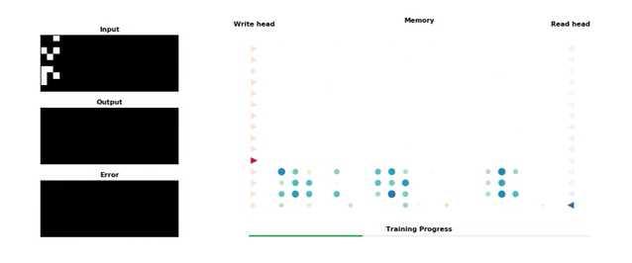
Neural Turing Machines: Demo
Demonstration: Training on Copy Task
Figure from Snips AI's Medium Post
Neural Turing Machines, Graves et. al., arXiv:1410.5401
Notes:
Example of the training procedure of the NTM. The model is given random input sequences and updates its parameters at every step. The output image represents the output from the model at that stage of training, with the corresponding error with regards to the expected output. The state of the memory as the model reads the input and write the output is displayed on the right, with the positions of the corresponding heads. Inspired by A. Graves’ animation at NIPS
- Learns when to read and write by manipulating e_t, a_t

Slide 59
Neural Turing Machines: Attention Model
Generating w_{t}
Content Based
Example: QA Task
Score sentences by similarity with Question
Weights as softmax of similarity scores
Location Based
Example: Copy Task
Move to address (i+1) after writing to index (i)
Weights ≈ Transition probabilities
Neural Turing Machines, Graves et. al., arXiv:1410.5401
Notes:
The attention mechanism decides which parts of the memory must be focused on
The controller outputs the normalized weights
Weights based on 2 attention mechanisms: content based, location based
Content Based:
Focuses attention based on similarity of key vector & vectors in memory
Useful for retrieval based lookup
Location Based:
Focuses attention based on addresses of vectors in memory
Useful for iteration over memory. E.g. Copy Task

Slide 60

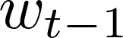

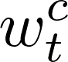


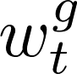
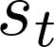
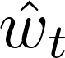
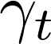
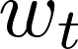
Neural Turing Machine: Attention Model
Steps for generating w_{t}
Content Addressing
Peaking
Interpolation
Convolutional Shift (Location Addressing)
Sharpening
Prev. State
Controller
Outputs
CA
I
CS
S
Neural Turing Machines, Graves et. al., arXiv:1410.5401

Slide 61
Neural Turing Machine: Attention Model
Prev. State
Controller
Outputs
:Vector (length M) produced by Controller
Neural Turing Machines, Graves et. al., arXiv:1410.5401

Slide 62
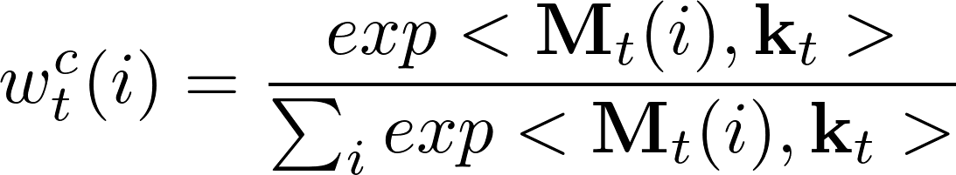
Neural Turing Machine: Attention Model
Prev. State
Controller
Outputs
Step 1: Content Addressing (CA)
CA
Neural Turing Machines, Graves et. al., arXiv:1410.5401

Slide 63
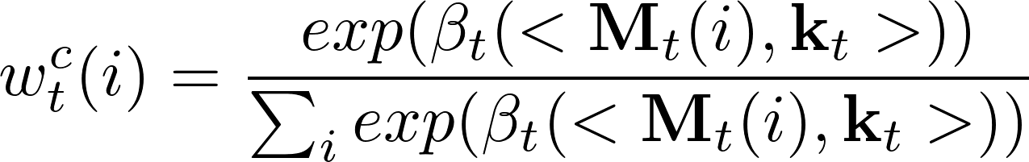
Neural Turing Machine: Attention Model
Prev. State
Controller
Outputs
Step 2: Peaking
CA
Neural Turing Machines, Graves et. al., arXiv:1410.5401

Slide 64
Neural Turing Machine: Attention Model
Prev. State
Controller
Outputs
Step 3: Interpolation (I)
CA
I
Neural Turing Machines, Graves et. al., arXiv:1410.5401

Slide 65
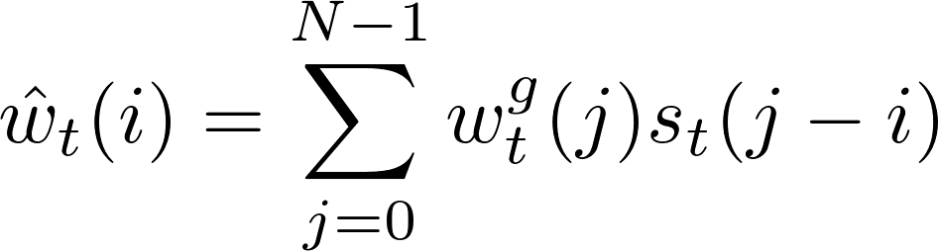
Neural Turing Machine: Attention Model
Prev. State
Controller
Outputs
Step 4: Convolutional Shift (CS)
Controller outputs , a normalized distribution over all N possible shifts
Rotation-shifted weights computed as:
CA
I
CS
Neural Turing Machines, Graves et. al., arXiv:1410.5401

Slide 66
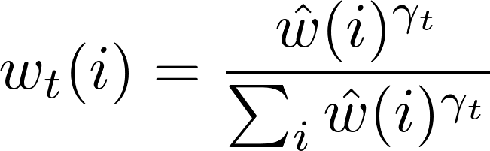
Neural Turing Machine: Attention Model
Prev. State
Controller
Outputs
Step 5: Sharpening (S)
Uses to sharpen as:
CA
I
CS
S
Neural Turing Machines, Graves et. al., arXiv:1410.5401

Slide 67
Neural Turing Machine: Controller Design
Feed-forward: faster, more transparency & interpretability about function learnt
LSTM: more expressive power, doesn’t limit the number of computations per time step
Both are end-to-end differentiable!
Reading/Writing -> Convex Sums
w_{t} generation -> Smooth
Controller Networks
Neural Turing Machines, Graves et. al., arXiv:1410.5401
Notes:
If one compares the controller to the central processing unit in a digital computer and the memory matrix to RAM, then the hidden activations of the recurrent
controller are akin to the registers in the processor.

Slide 68
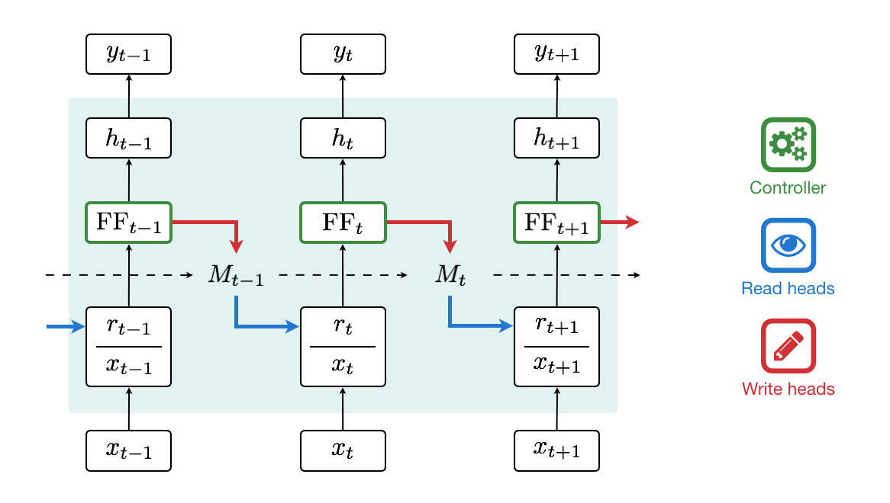
Neural Turing Machine: Network Overview
Unrolled Feed-forward Controller
Figure from Snips AI's Medium Post
Neural Turing Machines, Graves et. al., arXiv:1410.5401
Notes:
A Neural Turing Machine unfolded in time. The controller (green), a feed-forward neural network, depends on both the input x and the read vector r. It emits read (blue) and write (red) heads to interact with the memory M.

Slide 69
Neural Turing Machines vs. MemNNs
MemNNs
Memory is static, with focus on retrieving (reading) information from memory
NTMs
Memory is continuously written to and read from, with network learning when to perform memory read and write

Slide 70
Neural Turing Machines: Experiments
Task | Network Size |  | Number of Parameters
 | NTM w/ LSTM* | LSTM | NTM w/ LSTM | LSTM
Copy | 3 x 100 | 3 x 256 | 67K | 1.3M
Repeat Copy | 3 x 100 | 3 x 512 | 66K | 5.3M
Associative | 3 x 100 | 3 x 256 | 70K | 1.3M
N-grams | 3 x 100 | 3 x 128 | 61K | 330K
Priority Sort | 2 x 100 | 3 x 128 | 269K | 385K
Neural Turing Machines, Graves et. al., arXiv:1410.5401

Slide 71
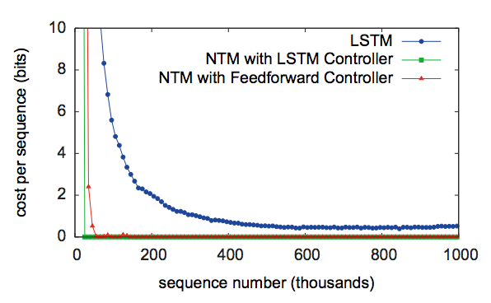
Neural Turing Machines: ‘Copy’ Learning Curve
Trained on 8-bit sequences, 1<= sequence length <= 20
Neural Turing Machines, Graves et. al., arXiv:1410.5401

Slide 72
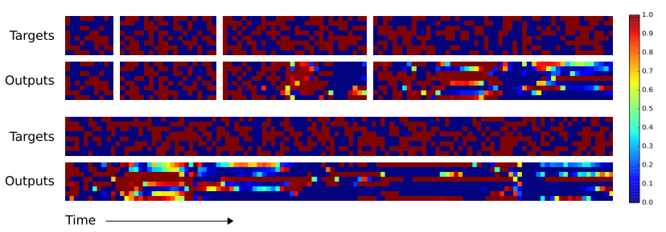
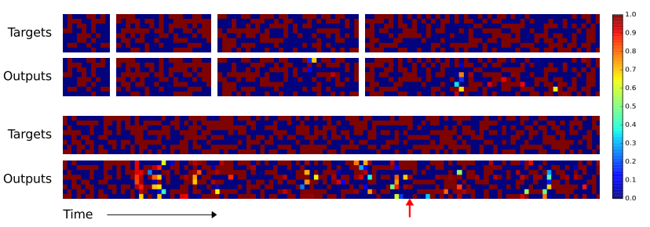
Neural Turing Machines: ‘Copy’ Performance
LSTM
NTM
Neural Turing Machines, Graves et. al., arXiv:1410.5401
Notes:
Describe x, y axes

Slide 73
Neural Turing Machines triggered an outbreak of Memory Architectures!
Notes:
Add the storm here!

Slide 74
Dynamic Neural Turing Machines
Experimented with addressing schemes
Dynamic Addresses: Addresses of memory locations learnt in training – allows non-linear location-based addressing
Least recently used weighting: Prefer least recently used memory locations + interpolate with content-based addressing
Discrete Addressing: Sample the memory location from the content-based distribution to obtain a one-hot address
Multi-step Addressing: Allows multiple hops over memory
Results: bAbI QA Task
 | Location NTM | Content NTM |  | Soft DNTM | Discrete DNTM
1-step | 31.4% | 33.6% |  | 29.5% | 27.9%
3-step | 32.8% | 32.7% |  | 24.2% | 21.7%
Dynamic Neural Turing Machine with Soft and Hard Addressing Schemes, Gulchere et. al., arXiv:1607.00036

Slide 75
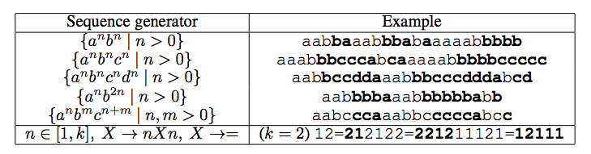
Stack Augmented Recurrent Networks
Learn algorithms based on stack implementations (e.g. learning fixed sequence generators)
Uses a stack data structure to store memory (as opposed to a memory matrix)
Inferring Algorithmic Patterns with Stack-Augmented Recurrent Nets, Joulin et. al., arXiv:1503.01007

Slide 76
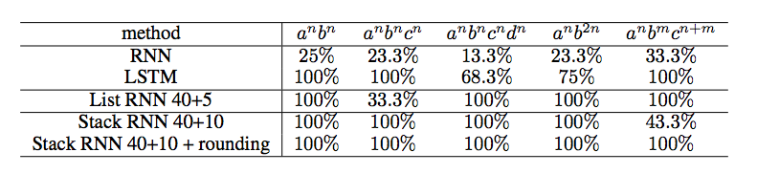
Stack Augmented Recurrent Networks
Blurry ‘push’ and ‘pop’ on stack. E.g.:
Some results:
Inferring Algorithmic Patterns with Stack-Augmented Recurrent Nets, Joulin et. al., arXiv:1503.01007

Slide 77
Differentiable Neural Computers
Advanced addressing mechanisms:
Content Based Addressing
Temporal Addressing
Maintains notion of sequence in addressing
Temporal Link Matrix L (size NxN), L[i,j] = degree to which location I was written to after location j.
Usage Based Addressing
Hybrid computing using a neural network with dynamic external memory, Graves et. al., Nature vol. 538

Slide 78
DNC: Usage Based Addressing
Writing increases usage of cell, reading decreases usage of cell
Least used location has highest usage-based weighting
Interpolate b/w usage & content based weights for final write weights
Hybrid computing using a neural network with dynamic external memory, Graves et. al., Nature vol. 538
Notes:
- Memory utilization. Reading doesn’t utilize memory, only writing does
We trained
the DNC on a copy problem, in which a series of 10 random sequences was presented as input. After each input sequence was presented, it was recreated as output. Once the output was generated, that input sequence was not needed again and could be erased from memory. We used a DNC with a feedforward controller and a memory of 10 locations—insufficient to store all 50 input vectors with no overwriting. The goal was to test whether the memory allocation system would be used to free and re-use locations as needed. As shown by the read and write weightings, the same locations are repeatedly used. The free gate is active during the read phases, meaning that locations are deallocated immediately after they are read from. The allocation gate is active during the write phases, allowing the deallocated locations to be re-used.

Slide 79
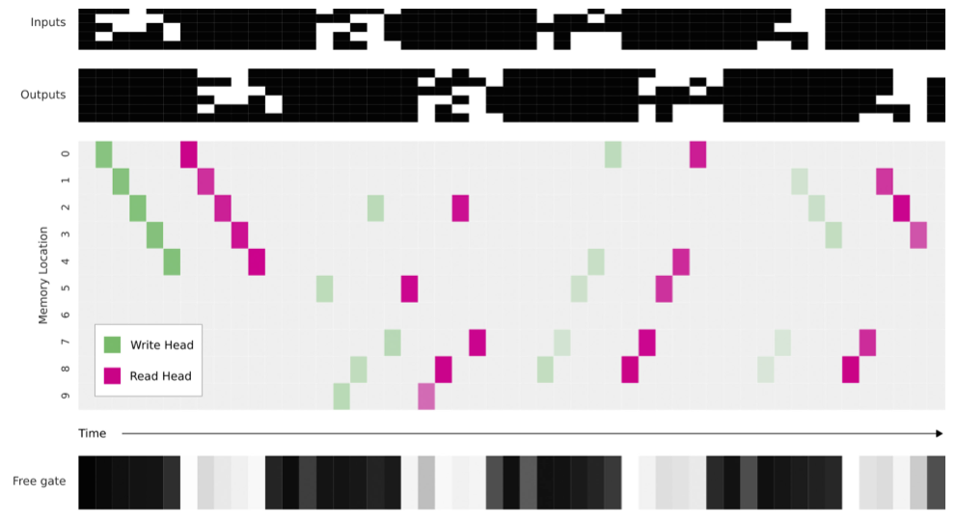
DNC: Example
Hybrid computing using a neural network with dynamic external memory, Graves et. al., Nature vol. 538
Notes:
- Memory utilization. Reading doesn’t utilize memory, only writing does
We trained the DNC on a copy problem, in which a series of 10 random sequences was presented as input. After each input sequence was presented, it was recreated as output. Once the output was generated, that input sequence was not needed again and could be erased from memory. We used a DNC with a feedforward controller and a memory of 10 locations—insufficient to store all 50 input vectors with no overwriting. The goal was to test whether the memory allocation system would be used to free and re-use locations as needed. As shown by the read and write weightings, the same locations are repeatedly used. The free gate is active during the read phases, meaning that locations are deallocated immediately after they are read from. The allocation gate is active during the write phases, allowing the deallocated locations to be re-used.

Slide 80
DNC: Improvements over NTMs
NTM
Large contiguous blocks of memory needed
No way to free up memory cells after writing
DNC
Memory locations non-contiguous, usage-based
Regular de-allotment based on usage-tracking
Hybrid computing using a neural network with dynamic external memory, Graves et. al., Nature vol. 538

Slide 81
DNC: Experiments
Graph Tasks
Graph Representation: (source, edge, destination) tuples
Types of tasks:
Traversal: Perform walk on graph given source, list of edges
Shortest Path: Given source, destination
Inference: Given source, relation over edges; find destination
Hybrid computing using a neural network with dynamic external memory, Graves et. al., Nature vol. 538

Slide 82
DNC: Experiments
Graph Tasks
Training over 3 phases:
Graph description phase: (source, edge, destination) tuples fed into the graph
Query phase: Shortest path (source, ____, destination), Inference (source, hybrid relation, ___), Traversal (source, relation, relation …, ___)
Answer phase: Target responses provided at output
Trained on random graphs of maximum size 1000
Hybrid computing using a neural network with dynamic external memory, Graves et. al., Nature vol. 538

Slide 83
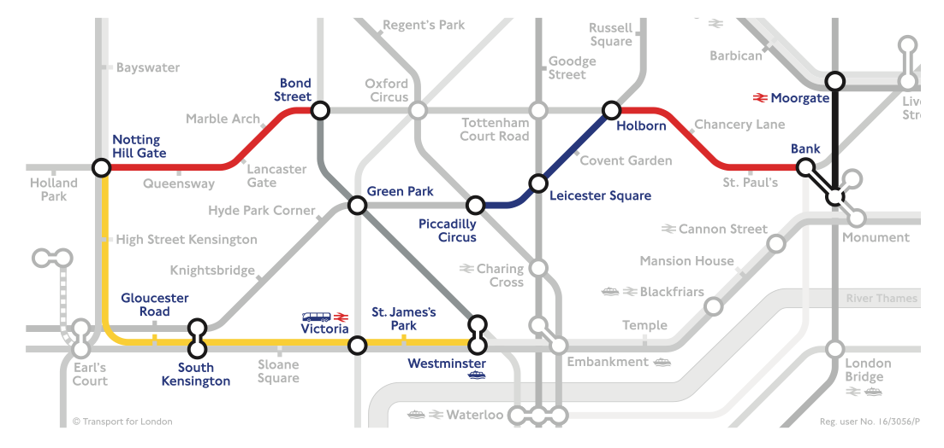
DNC: Experiments
Graph Tasks: London Underground
Hybrid computing using a neural network with dynamic external memory, Graves et. al., Nature vol. 538

Slide 84
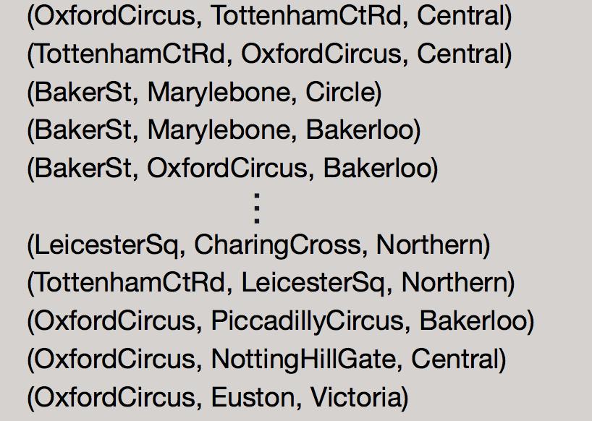
DNC: Experiments
Graph Tasks: London Underground
Input Phase
Hybrid computing using a neural network with dynamic external memory, Graves et. al., Nature vol. 538

Slide 85
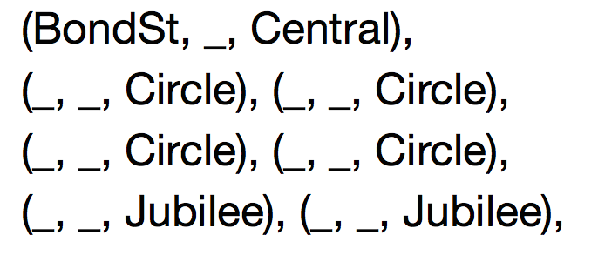

DNC: Experiments
Graph Tasks: London Underground
Traversal Task
Query Phase
Answer Phase
Hybrid computing using a neural network with dynamic external memory, Graves et. al., Nature vol. 538

Slide 86


DNC: Experiments
Graph Tasks: London Underground
Shortest Path Task
Query Phase
Answer Phase
Hybrid computing using a neural network with dynamic external memory, Graves et. al., Nature vol. 538

Slide 87

DNC: Experiments
Graph Tasks: Freya’s Family Tree
Hybrid computing using a neural network with dynamic external memory, Graves et. al., Nature vol. 538

Slide 88
Conclusion
Machine Learning models require memory and multi-hop reasoning to perform AI tasks better
Memory Networks for Text are an interesting direction but very simple
Generic architectures with memory, such as Neural Turing Machine, limited applications shown
Future directions should be focusing on applying generic neural models with memory to more AI Tasks.
Hybrid computing using a neural network with dynamic external memory, Graves et. al., Nature vol. 538

Slide 89
Reading List
Karol Kurach, Marcin Andrychowicz & Ilya Sutskever Neural Random-Access Machines, ICLR, 2016
Emilio Parisotto & Ruslan Salakhutdinov Neural Map: Structured Memory for Deep Reinforcement Learning, ArXiv, 2017
Pritzel et. al. Neural Episodic Control, ArXiv, 2017
Oriol Vinyals,Meire Fortunato, Navdeep Jaitly Pointer Networks, ArXiv, 2017
Jack W Rae et al., Scaling Memory-Augmented Neural Networks with Sparse Reads and Writes, ArXiv 2016
Antoine Bordes, Y-Lan Boureau, Jason Weston, Learning End-to-End Goal-Oriented Dialog, ICLR 2017
Junhyuk Oh, Valliappa Chockalingam, Satinder Singh, Honglak Lee, Control of Memory, Active Perception, and Action in Minecraft, ICML 2016
Wojciech Zaremba, Ilya Sutskever, Reinforcement Learning Neural Turing Machines, ArXiv 2016

